Slide 1

2015 Flight Delays and Cancellations
Group Project
May 15, 2021
Group 3: Vanessa Delarosa, Esmeralda Hoxha, Omer Khan, Judy Liang, Hamza Moussannef, Tal Yakobi

Slide 2
Overview
In 2014, DOT’s aviation consumer protection division received 15,539 complaints. In 2015, they received 20,170 complaints.
In December 2015, the department received 1,565 complaints about the airline services from the consumers.
In December 2014, 1,065 complaints were filed about airline services.
Many of the complaints were about flight delays and cancellations
Main Dataset is of 14 airlines reporting flight information for year 2015
Contains over five million records with 32 columns

Slide 3
Goals
We would like to analyze our dataset in order to determine the airlines that provide the best service
We will analyze our data in order to predict flight delays.
Various Statistics regarding airlines were reported.

Slide 4
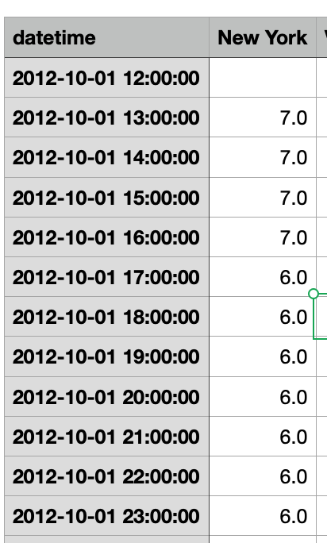
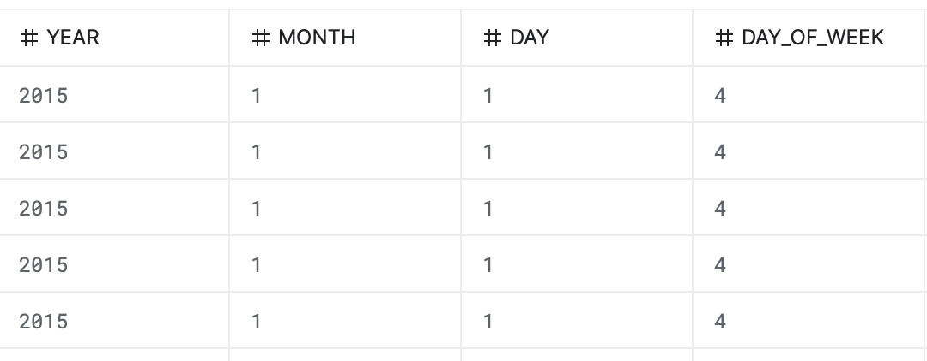
Challenges
Cleaning up the data sets
7 different data sets (flights, windspeed, temperature, airlines, airports etc)
Combining or merging the different data sets
Date time formats

Slide 5
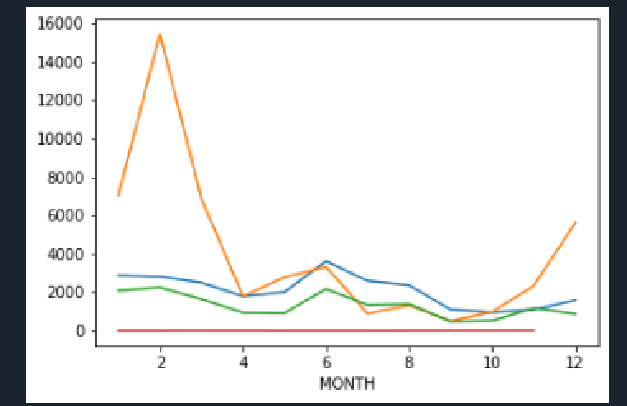
Descriptive Analytics
Delays
Southwest Airlines Co. recorded the highest number of delays
Hawaiian Airlines Inc. recorded the lowest number of delays
Flights From San Francisco International Airport to Los Angeles International Airport recorded the highest number of delays
Cancellations
WN = Southwest Airlines Co. recorded the highest number of Air Carrier Cancellations
MQ = American Eagle Airlines Inc. recorded the highest Extreme Weather Cancellation
EV = Atlantic Southeast Airlines recorded the highest number of National Aviation System Cancellations
WN = Southwest Airlines Co. recorded the highest number of Cancellations related to security
Extreme Weather was the main factor behind cancellations
___ Air Carrier
__ Extreme Weather
__ National Aviation System
__ Security

Slide 6
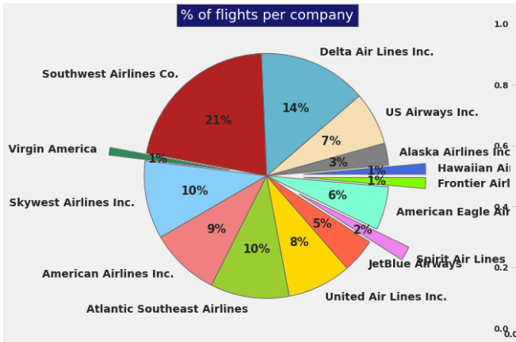
Analyzing the proportion of flights for each company
Notes:
As seen from the pie chart above, Southwest airline has the highest percentage of flights with 21%, as was expected since Southwest has the highest number of delays

Slide 7
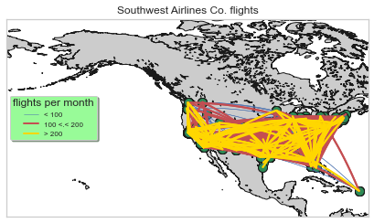
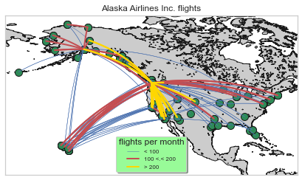
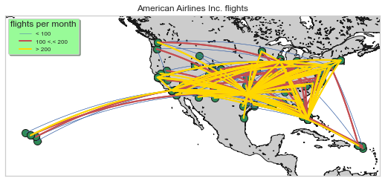
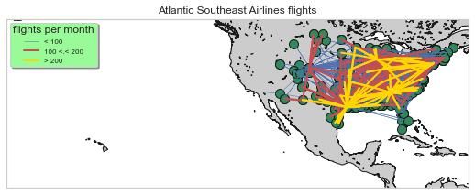
Notes:
The maps show us the destination and routes for 4 airlines companies that we choose base on their performance and destinations.
We can see how different airlines works. For example, Atlantic Southeast airline works more on the east coast. And Alaska focus more on long distance destination.

Slide 8
Multilinear Regression Model
Effects of weather conditions in a departure flight delay for NYC.
Step #1: Defining dependent variable and independent variables.
Y: Departure Delay (in min)
X: Wind, Humidity, Temperature, Pressure
Step #2: Splitting data in 70% training and 30% test dataset.
Step #3: Fit the regression model.
Step #4: Evaluate the model.
Step #5: Result of the model.

Slide 9
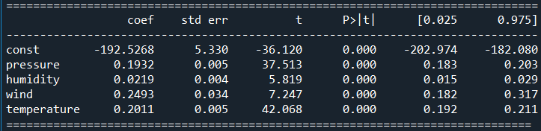
Results of our model
y = b0 + b1X1 + b2X2 + ... + bkXk
Departure_Delay = - 192.52 + 0.19*pressure + 0.02*humidity + 0.24*wind + 0.20*temperature
Most significant variables are: wind and temperature.
Departure_Delay(prediction) = -192.52 + 0.19*985 + 0.02*34 + 0.24*6 + 0.20*70 = 10.74 min delay

Slide 10
THANK YOU !

